Slide 1
RESUME CLASSIFICATION USING PYTHON PROJECT GUIDE: ADVAITH REDDY MENTOR: NATARAJAN SENGUTTUVAN P-145 Group2
Afreen fatima
Akanksha Pathak
Lakshmi supriya karri
Yenuganti sai pranay goud
Chokkarapu varun
Rohit kumar
Suklesh satyamsetty

Slide 2
Introduction to NLP
NLP in simple words is “Dealing with text data”
Falls under Artificial Intelligence(AI) – A computer performing the tasks that a human can do.
Problem Statement
Reduce the human intervention in classifying the resume with significant accuracy.
Given the resumes, we are expected to import, clean and model the text data.
Deploy the model using streamlit/flask.

Slide 3
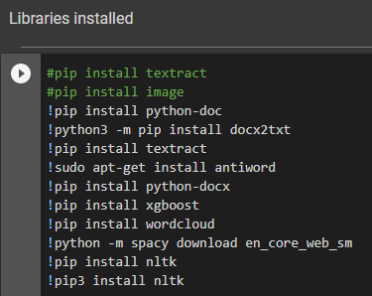
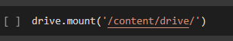
Importing the data
Files under Zip folder are uploaded to drive and accessed by using Google Colab code editor
Using the above code the drive is mounted.
Further, all the files are accessed with their respective category.
Total of 77 resumes can be accessed.
Considering all the resumes under one variable.
Following libraries are to be installed prior getting into the code

Slide 4
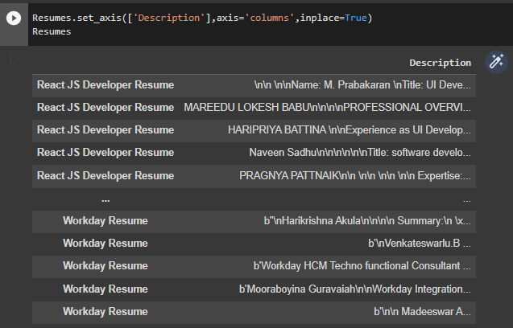
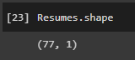
Reading the data
All the files are read into variable “Resumes” with column name as ‘Description’
A total of 77 resumes are imported and can be viewed.
Dropped 2 resumes of Internships.

Slide 5
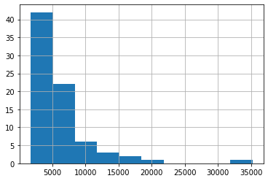
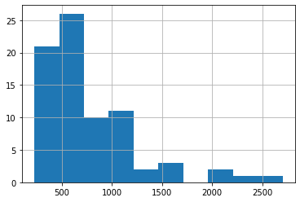
Exploratory Data Analysis (EDA)
Shows the histogram with total length of words in all resumes
Shows the histogram of individual word length in all resumes

Slide 6
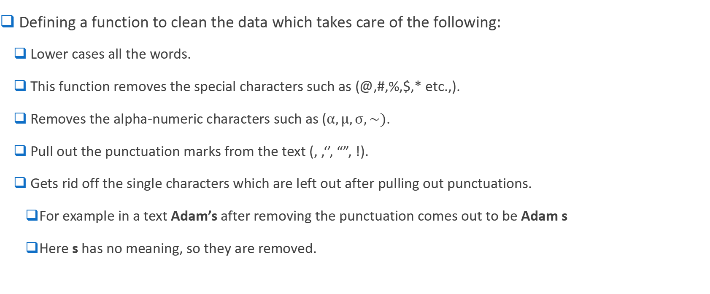
Cleaning the data
Defining a function to clean the data which takes care of the following:
Lower cases all the words.
This function removes the special characters such as (@,#,%,$,* etc.,).
Removes the alpha-numeric characters such as ($α,µ,σ,\sim )$.
Pull out the punctuation marks from the text (, ,‘’, “”, !).
Gets rid off the single characters which are left out after pulling out punctuations.
For example in a text Adam’s after removing the punctuation comes out to be Adam s
Here s has no meaning, so they are removed.

Slide 7
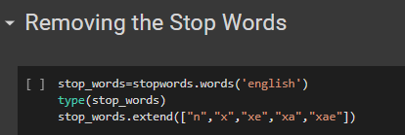
Stop Words
These are a set of commonly used words which don’t provide useful information for our text.
Eliminating such words allows us to focus more important text.
Using NLTK library we have imported stop words in English language.
We have extended our stop words list as shown in the code.

Slide 8
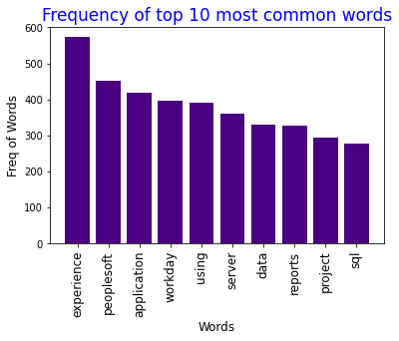
Exploratory Data Analysis (EDA)
These are the top 10 frequent words in the given resumes after removing the stop words.
Most frequent word in all the resumes is ‘Experience’ with almost more than 550 times.

Slide 9
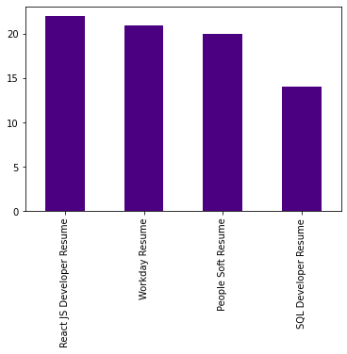
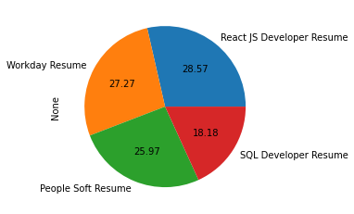
Out of all the resumes, this bar chart shows the count (each category) of resumes
Out of all the resumes, this pie chart shows the percentage (each category) of resumes

Slide 10
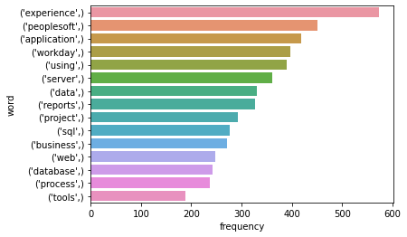
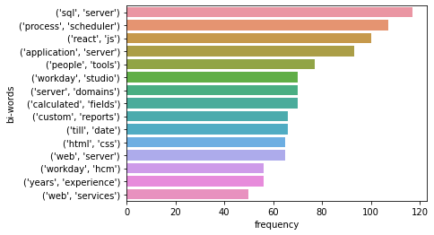
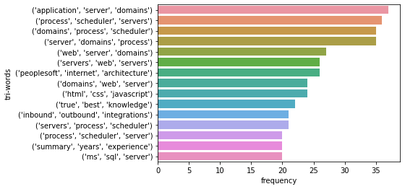
N-grams (Words, Bi-grams, Tri-grams)

Slide 11
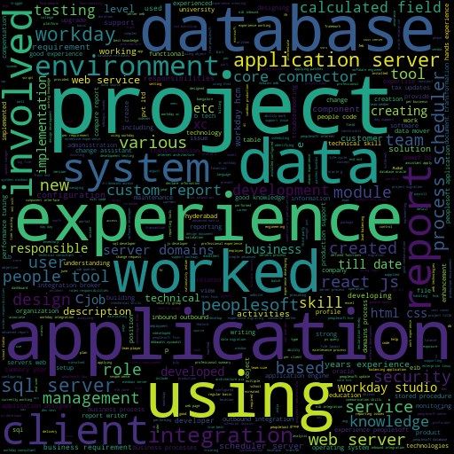
Word Cloud
This word cloud is built considering all the resumes and it depicts the word which is most frequent with a large text and others with a relatively smaller text.
Maximum words of 1000 is given as the parameter.

Slide 12
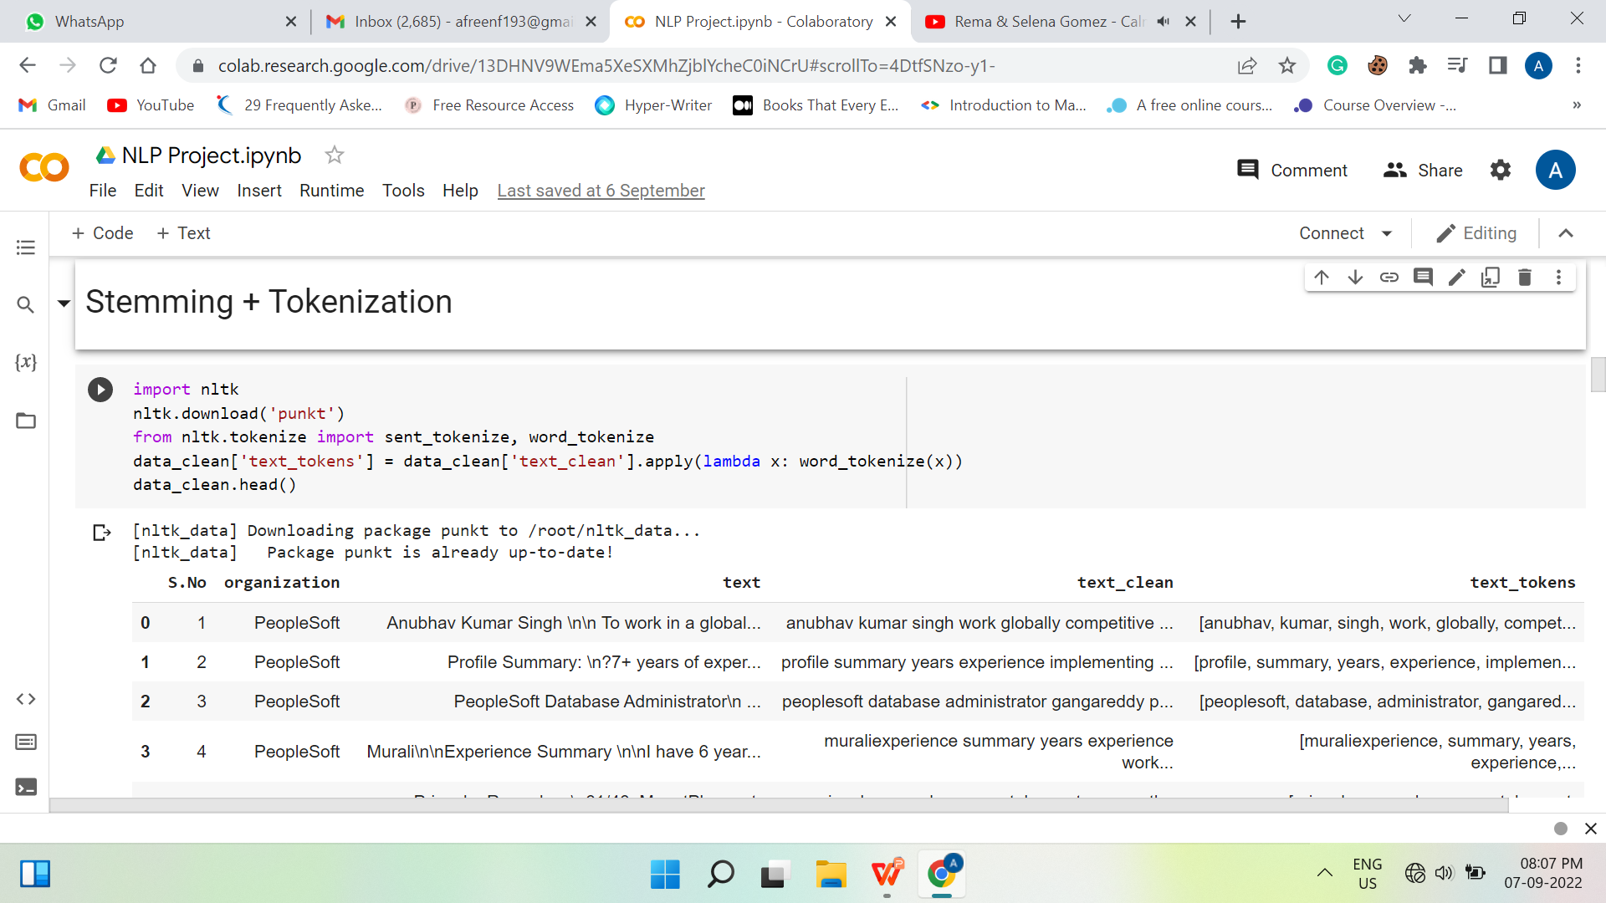
Text Pre-processing

Slide 13
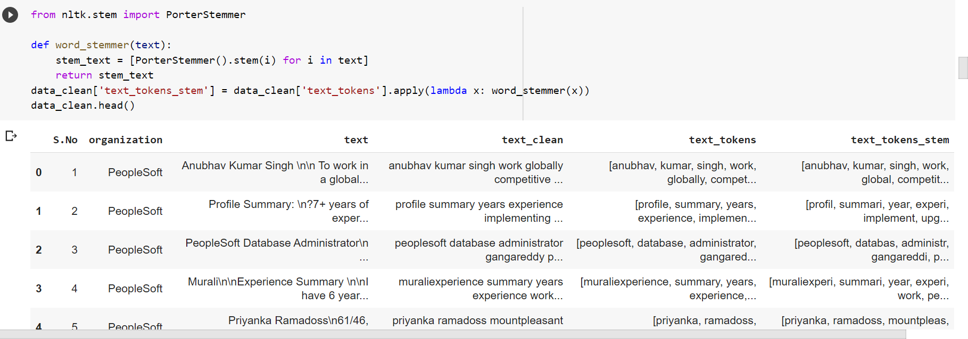
Stemming

Slide 14
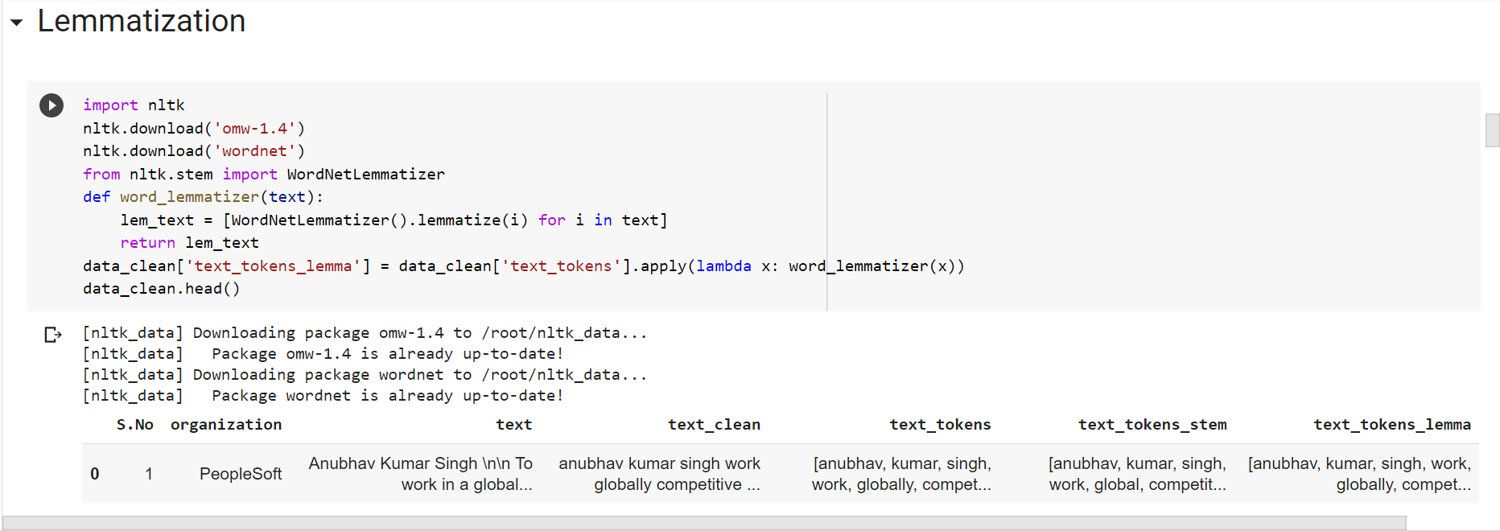
Lemmatization

Slide 15
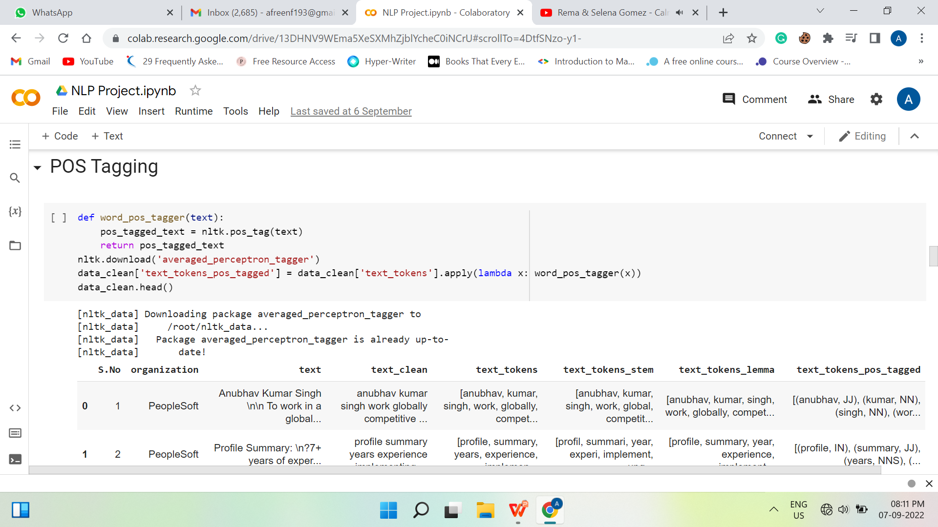
POS Tagging

Slide 16
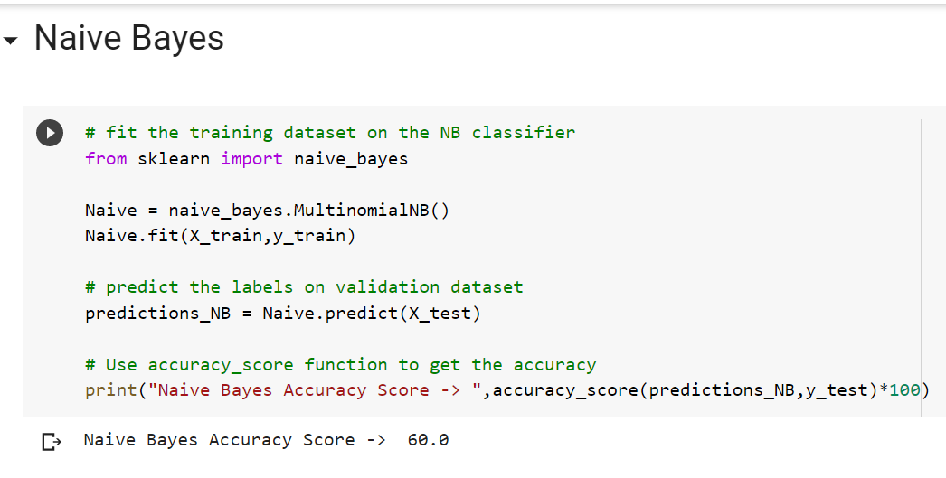
Naive Bayes

Slide 17
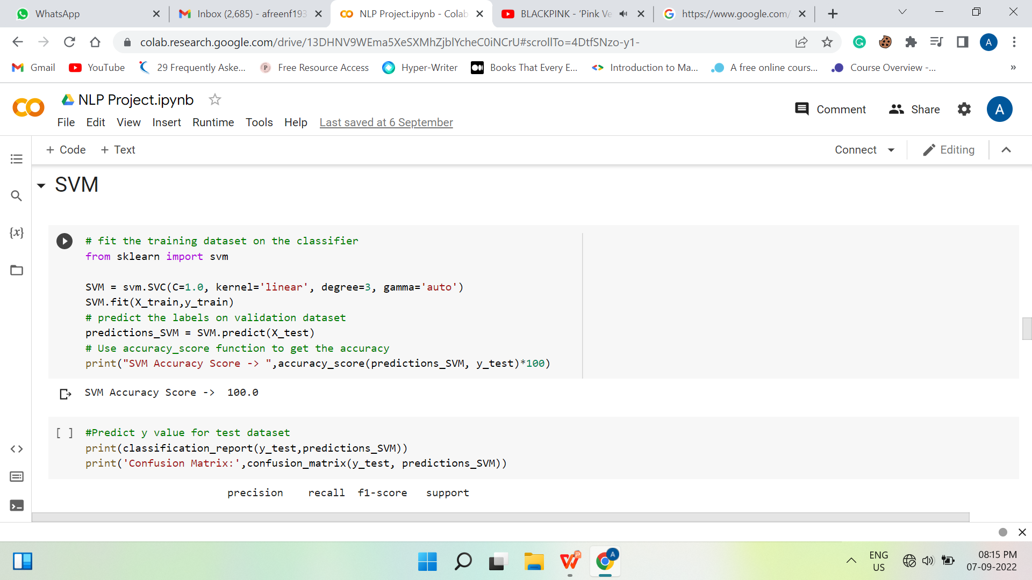
Support Vector Machine - SVM

Slide 18
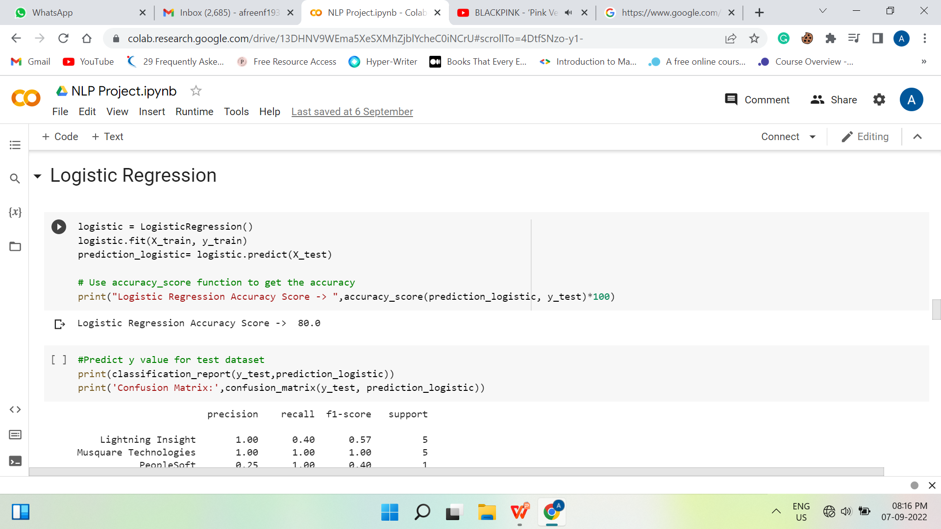
Logistic Regression

Slide 19
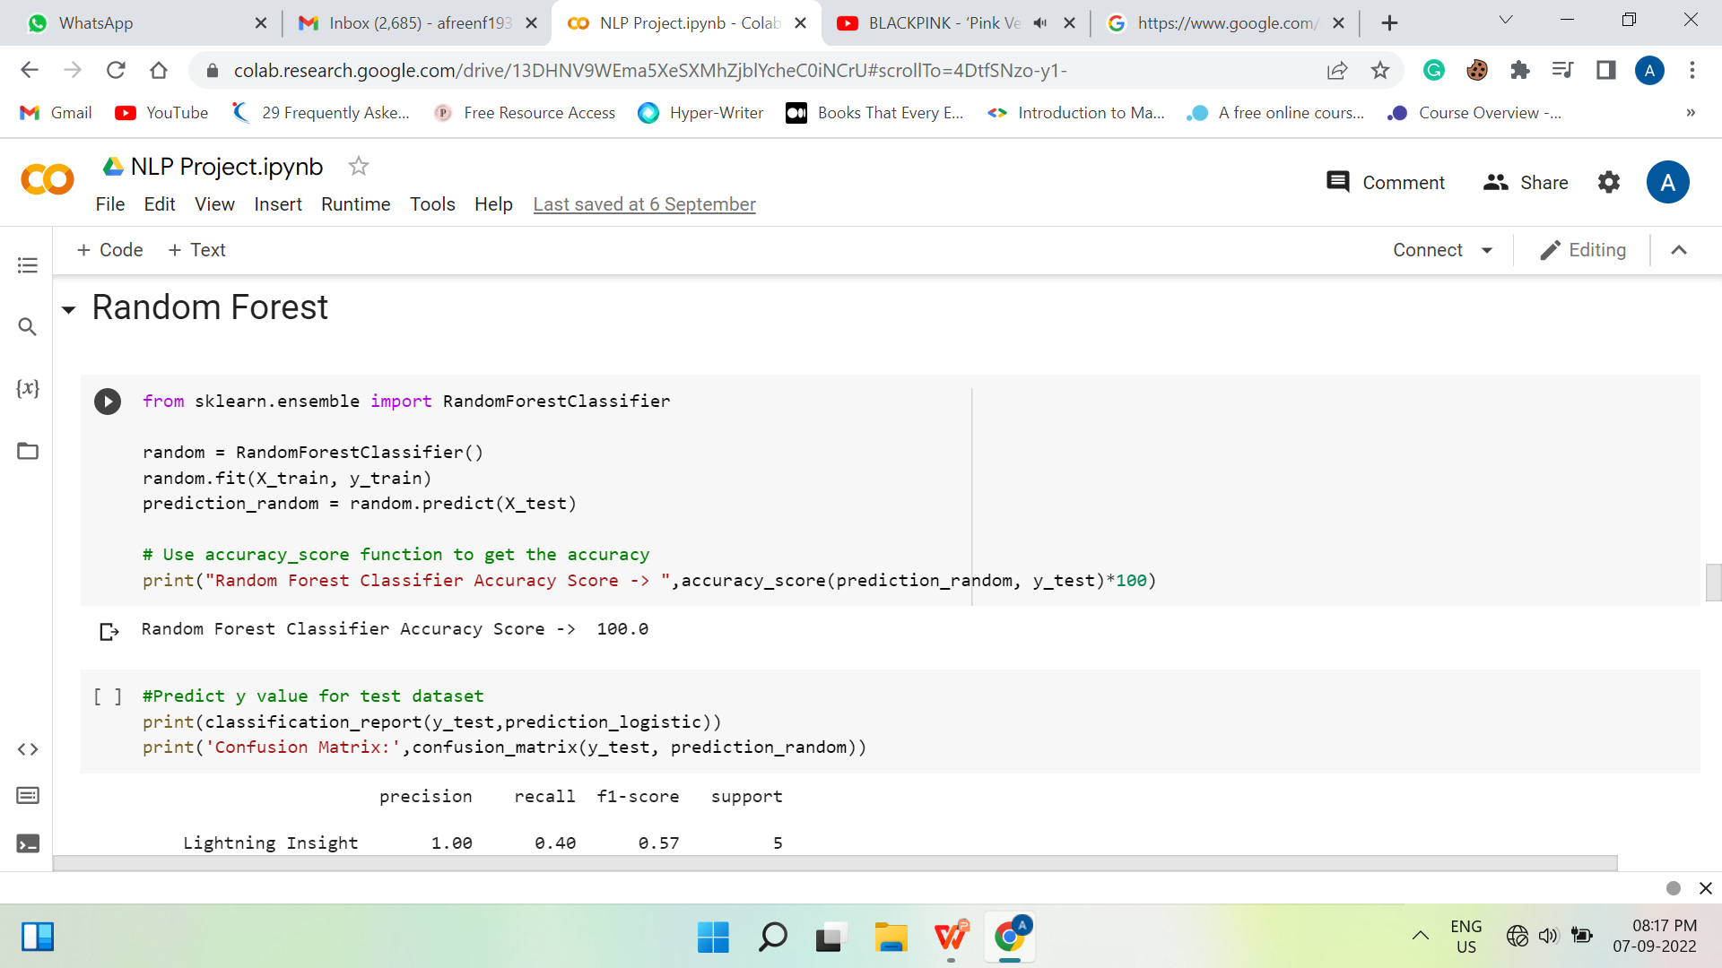
Random Forest

Slide 20
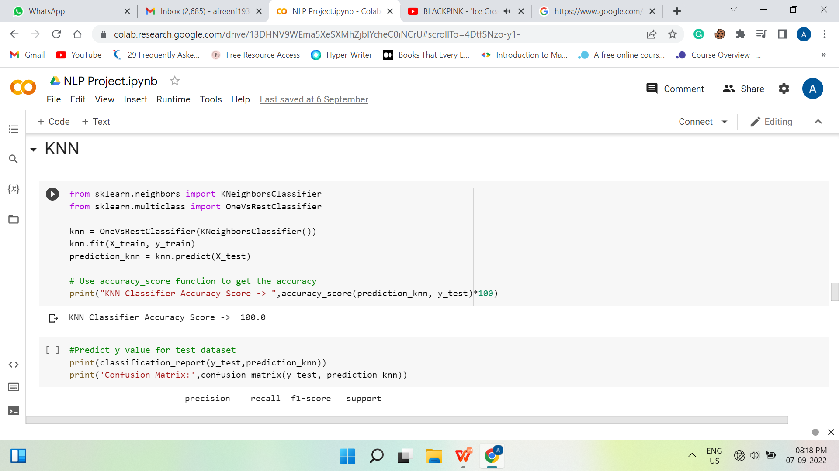
K-neighbours

Slide 21
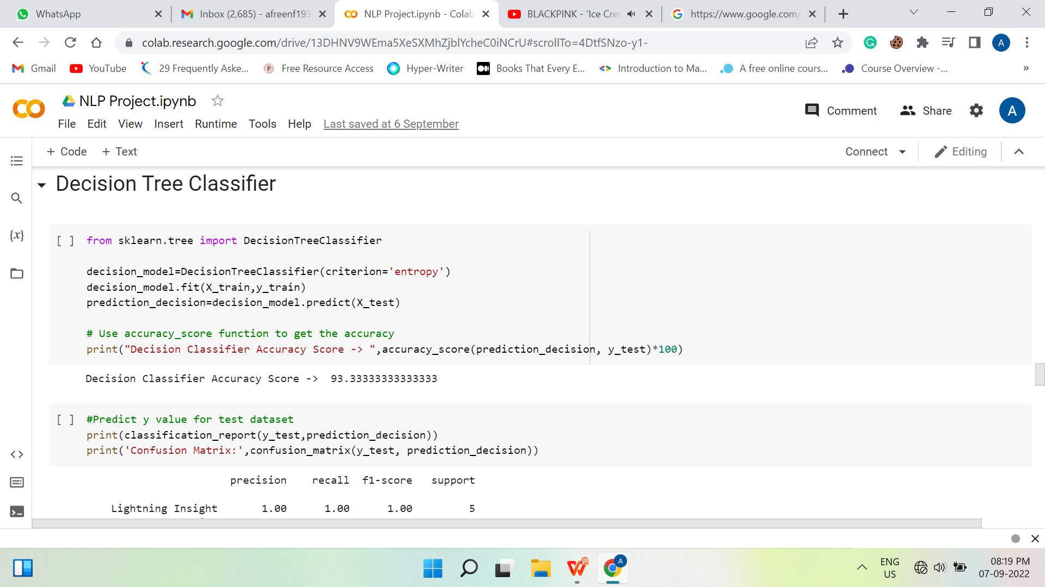
Decision Tree

Slide 22
Topic Modelling
This comes under ‘Unsupervised Learning’
It refers to the task of identifying the topics that best describes a set of documents.
Techniques used in topic modelling are LDA - Latent Dirichlet Allocation which follows the probabilistic approach.
Other techniques which use matrix factorization are LSI – Latent Semantic Indexing and NMF – Non Negative Matrix Factorization.
We have followed LDA approach in which
Latent means “HIDDEN”
Dirichlet Allocation means “TYPE OF PROBABILITY DISTRIBUTION”

Slide 23
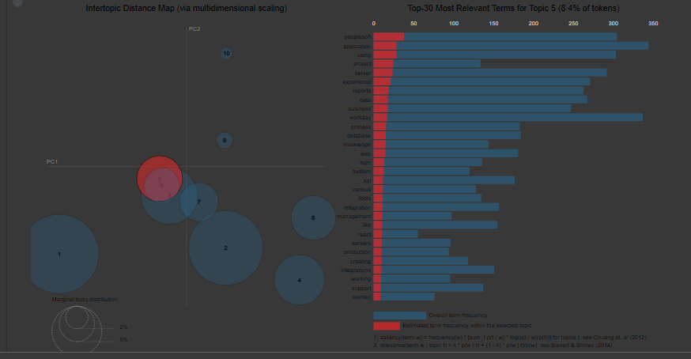
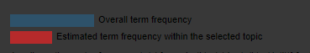
LDA – Latent Dirichlet Allocation
By using pyLDAvis library we can visualize the topic distribution
We can also access the top 30 probability words for the assigned topics are listed out.

Slide 24
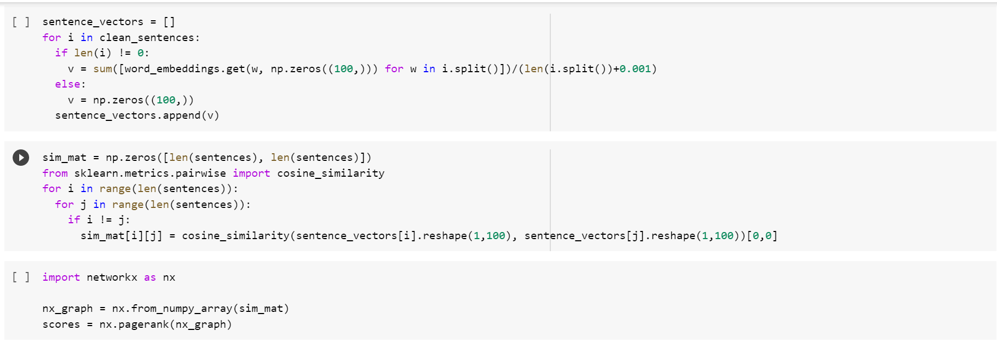
Summarization

Slide 25
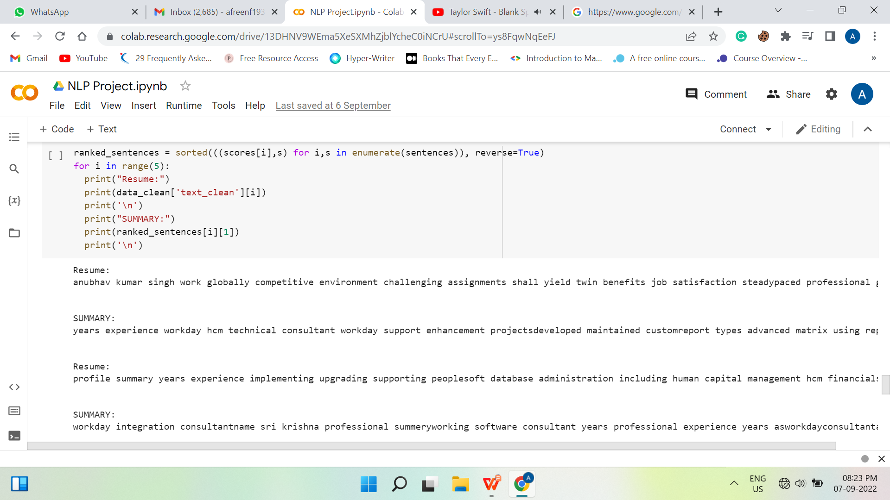

Slide 26
anubhav kumar singh work globally competitive environment challenging assignments shall yield twin benefits job satisfaction steadypaced professional growthprofessional experience current hcl current role system admin offshore skills shell scripting linux peoplesoft administration githubmanaging peoplesoft hcm peoplesoft fscm production environments along support environments installed linux windows osinvolved day day activities project migration database refresh system admin changes tax updates etctroubleshooting various servers like application servers web servers process scheduler serversapplying tuxedo weblogic middleware cpu patches various applicationsworking shell scripting used integration method exchange files external systemsinstallation troubleshooting tier setup per requirementreviewing vulnerabilities reported security teamsrenewal ssl weblogicvulnerability remediation whenever vulnerability report rmis teamworked pum peoplesoft update manager installation dpkworking knowledge ansible dockerdeveloping new shell scripts troubleshooting shell script failures techmahindra roleproject application support automationdevops tools peoplesoft admin skills shell scripting linux peoplesoft administration jenkins ansible project people tools upgrade hcm application upgrade project migration applications ntt cloud onpremises aws cloudworked shell scripting various application requirementworking ansible jenkins automated startstop various activities applicationbasic knowledge dockerapplying ssl certificates new released applicationsworked elastic search configuration peoplesoftgained knowledge aws resourcesstrong understanding unix architecturecommand trouble shooting unixlinux platformefficient using configuration management deployment tool like ansiblegood experience job scheduling via crontab ibm tivoli workload scheduler twshaving good knowledge automation using shell scripting continuous integration management using jenkins installing configuring jenkinsresponsible writing ansible playbook perform various taskmanaged administration tasks installation configuration applications troubleshooting performance related issueapplying tuxedo weblogic cpu patches various applicationsworking vulnerabilities reported security teamsreviewing platform certification information products platforms database servers web application servers browsers products peopletools server migration aws amazon web serviceinstallation peoplesoft server components application servers process scheduler servers tuxedo web logic servers new release peopletools unixlinux serversapplying latest patch peopletoolsinstalling configuring change assistant various upgrade passescreating running peopletools upgrade job peopletools upgradesetting performance monitorcreating new app web process scheduler domains post upgrade new linux severstroubleshooting common domain boot problemsidentifying configuring source target databases ca hcm application upgradeworking hcm pum imagescreating change packages using pum applying sourcetarget databases per requirementcreating application upgrade job using change assistant srdt pvt ltd srm group roleproject peoplesoft application database admin skills peoplesoft administration weblogic tuxedo app designer pum peopletools upgrade peoplesoft campus application upgrade maintaining production environments supporting environments installed windows server r oracle gpossess knowledge experience peoplesoft architecture administering peoplesoft server components application servers process cheduler servers tuxedo web logic servers pia peoplesoft internet architecture integration broker report nodes application issues technical issuespeoplesoft skills experience migrations production support ps applicationsexposure applying peoplesoft bundle updates change assistantexposure working windows unixlinux environments oracle databaseworking knowledge integration brokerrefreshed testing dev preprod prod environmentsexperience troubleshooting various servers like application servers web servers process scheduler serversexperienced providing support production development environmentsinstallation database servers web servers application server peoplesoft application hrms fscm cs cs hrms people tool installed configured ses secure enterprise search hrms instanceexperience installing oracle policy automation oracle policy modelling creating opa database existing database oracleimplemented single sign peoplesoft applicationsimplemented peoplesoft interaction hub integrate external content information peoplesoft applicationsupgraded people tool campus production environmentupgraded people tool finance testing environmentupgraded application cs configured pum peoplesoft update manager every new imageapplying tax updates bugs tailored change packages pumupgraded oracle database using dbua created instances people tools provide testing environmentsprepared upgrade status reports sheetscoordinated provided support offshore projectsimported self signed certificate weblogic provide secure port access instancesset terminal server provide central access people tools technicaldeveloperscreated tickets development team followed get resolution error occurred projects client drdo project single sign role peoplesoft admin environment people tool hrms fscm description single signon sso property access control multiple related independent software systems property user logs single id password gain access connected system systems without using different usernames passwords client netapp project support maintenance role peoplesoft adminl support environment peopletool hrms description handled ib related issue clear process scheduler cache per weekly maintenance process handled psadmin related activities acs personal detailsfathers name rajeev kumar singhdate birth sex malelanguage read write hindi englishready relocate yeseducation btech electrical electronic engineering

Slide 27
years experience workday hcm technical consultant workday support enhancement projectsdeveloped maintained customreport types advanced matrix using report writer toolworked custom report calculated fields schedule reports per client requirementsworked alerts notification reportsworked report transfers ownership task removed unnecessary reports schedulesworked worklets dashboards set announcements set hyperlink help accountdeveloped core connector document transformation integrations get changes file csv format xml outputgood experience core connector worker work employee demographics build benefit integrations account provisioning integrationscreated inboundoutbound integrations using workday studio corecloud connectorsusing eibs document transformation processdesign build maintain integrations types reports eib core connectors payroll connectors studioworked birt report created birt report per client requirement like change view reportused delivered etvxtt functions custom xslt file transform content csv file formatworked employee type contract type local global different countriesworked business process level security domains level securityinteract clients vendor regular basis gatheringclarifying business requirements testing deploymentworked delegation reassignments shift creation dashboard working workday consultant fireeye bangalore june till date workday skills report writer core hcm business process security eib core connector dt basic studio birtprogramming languages xmlxsltprofessional experiencecompany fireeyerole workday consultantduration june till dateproject workday support enhancementdescriptionfireeye publicly traded cybersecurity company headquartered milpitas california involved detection prevention major cyber attacks provides hardware software services investigate cybersecurity attacks protect malicious software analyze security risksresponsibilitiesgathering client business requirements configure workday solutionestimation planning change request cr executiondeveloped core connector document transformation integrations get changes file csv format xml outputgood experience core connector worker work employee demographics build benefit integrations account provisioning integrationscreated inboundoutbound integrations using workday studio corecloud connectorsusing eibs document transformation processdesign build maintain integrations types reports eib core connectors payroll connectors studioworked fixing issues based client requirementresponsible scheduling related interface programs monitoring timely basisused delivered etvxtt functions custom xslt file transform content csv file formatcreated design technical documentsconfiguring delivery service sequence generators business process definitions integration systemsworked onshore coordinators requirements gatheringproviding daily status reports onshore managers handling project management activities daily status discussion reporting work assignmentsmodifications implementing multiple enhancements existing integrations custom reports calculated field xsltexperience creating kinds custom reports like simple advancedworked security groups configured user based security group role based security groups created intersection security groupworked business process level security domains level securitybachelor technologybtech qis college engineering technology affiliated jntuk universityname swethagender femalenationality indianlanguages known english telugui hereby declare details particulars furnished true best knowledgebest regards swetha

Slide 28
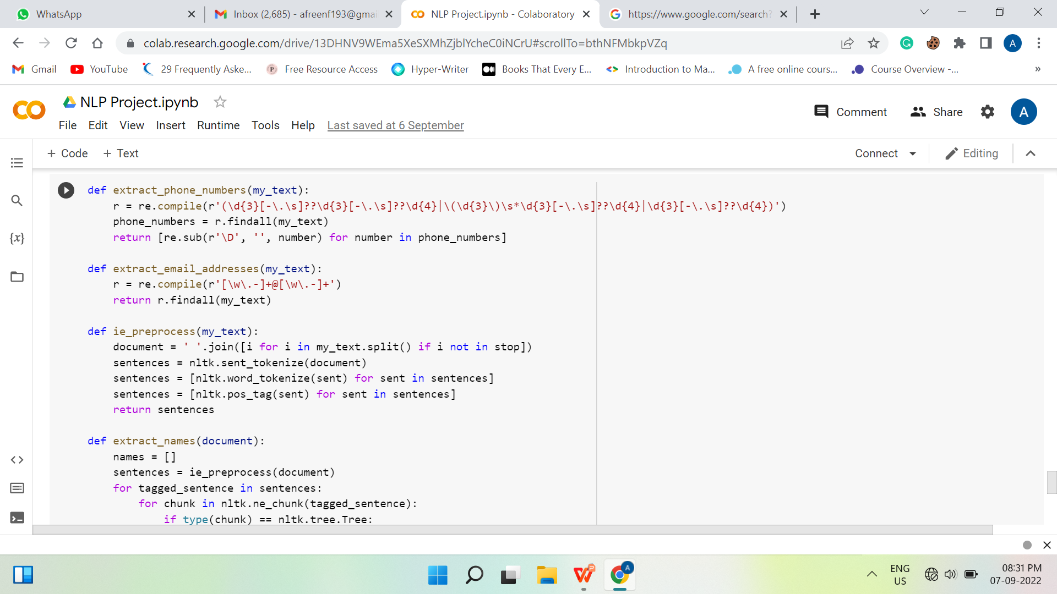
Extracting Features

Slide 29
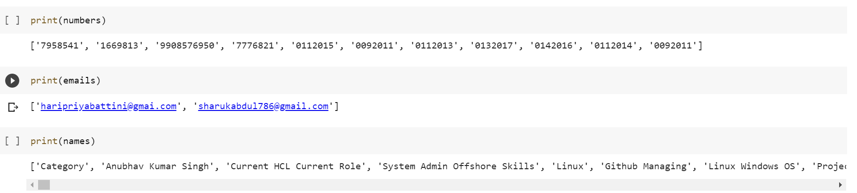

Slide 30
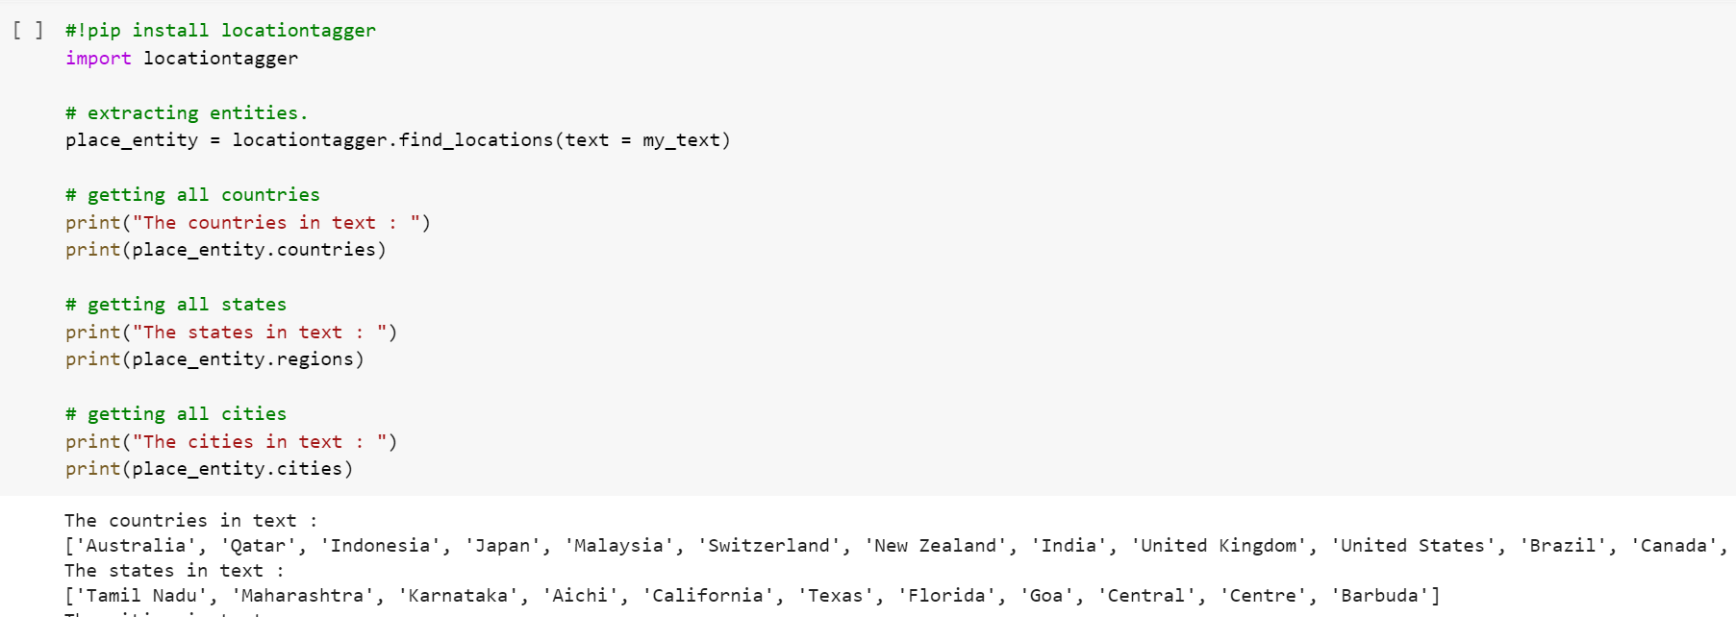
Location Tagger

Slide 31
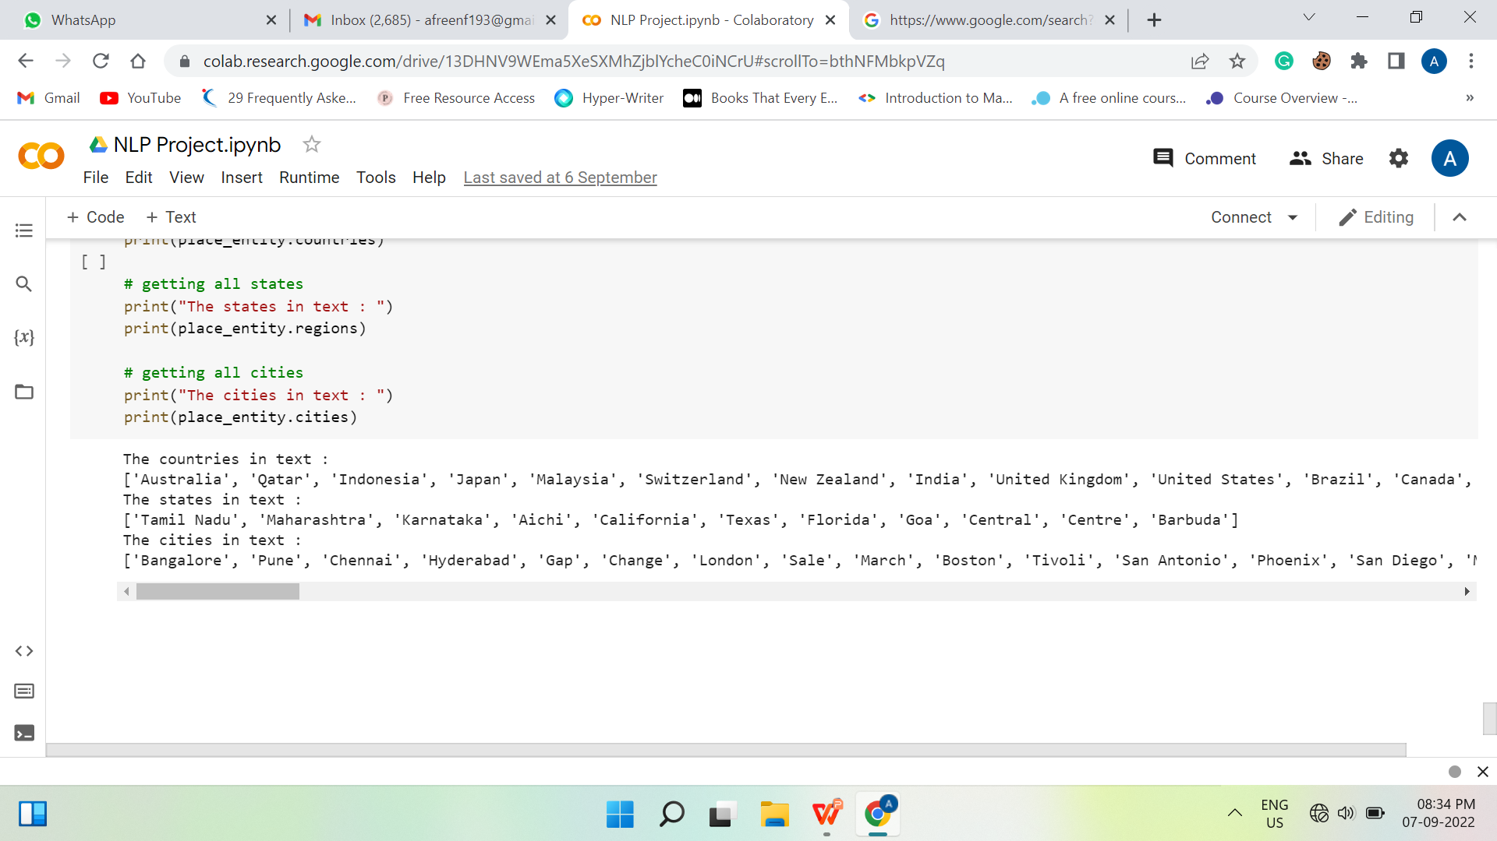

Slide 32
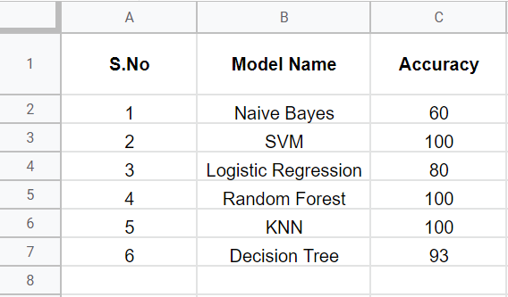
Model Accuracies

Slide 33
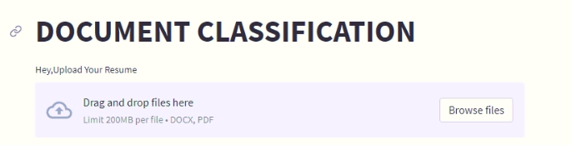
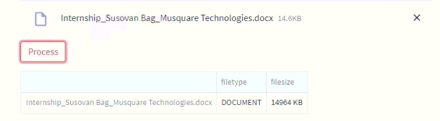
Deployment
The deployment is made using Streamlit library
Now, this will give out the prediction as:
0 → PeopleSoft Resume
1 → React JS Developer
2 → SQL Developer
3 → Workday Resume

Slide 34
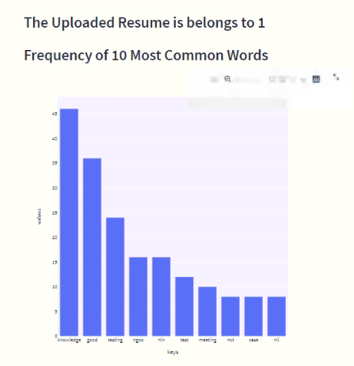
Bar chart for 10 frequent words

Slide 35
THANK YOU

